Slide 1
Process of Insurance Cancellation
Opening Script - Welcome to Grihum Housing Finance Limited. My name is (Agent Name) How may I assist you?​
Customer - I want the insurance refund amount, as my loan has been closed."
AI - Please note that this call is being recorded for quality assurance and training purposes.
AI - To verify the information, kindly provide the registered mobile number ( To check the details in finnone slide 2)
Verification - Any 3 of the below verification questions needs to be answered ( To verify the customer details slide 4 )
NAME
Date of Birth
Registered Email ID
Loan Sanction Amount
EMI Amount
AI - Thank you, Sir/Madam. Your verification has been completed.
If there are two LANs, AI should first confirm the specific sanctioned amount, as the LAN number is not recollected.
Once confirmed, proceed with the relevant LAN number. Check Point: FinnOne, Slide 3.
AI –First, we need to raise an insurance cancellation request. Once the insurance is cancelled, we can proceed with raising the refund request (to raise the the request in CRM the slide starts from 4to 12 )
AI –The insurance team will send you a message once the insurance has been cancelled
AI – It will take 10 working days to cancel the insurance
AI - Any other details required apart from this?
Thankyou for calling Grihum Housing Finance Limited. Have a pleasant day!

Slide 2
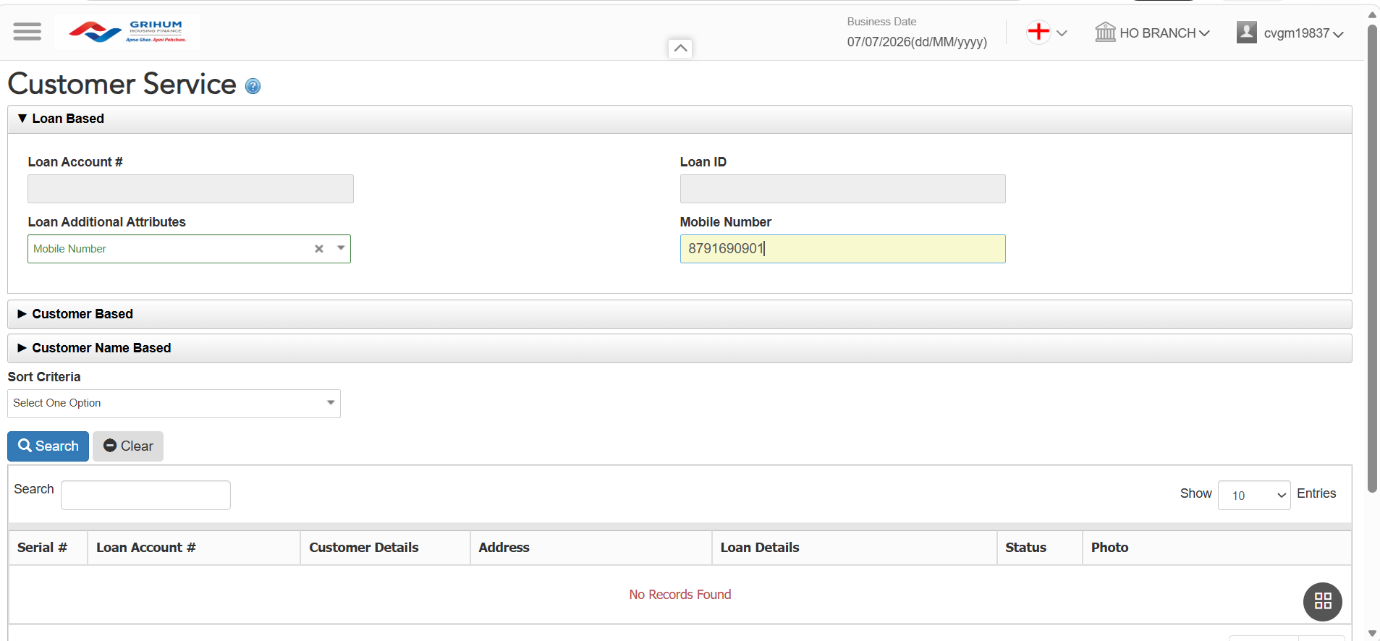
FINONE ​​
To verify the information, please provide the customer'sregistered mobile number.​​

Slide 3
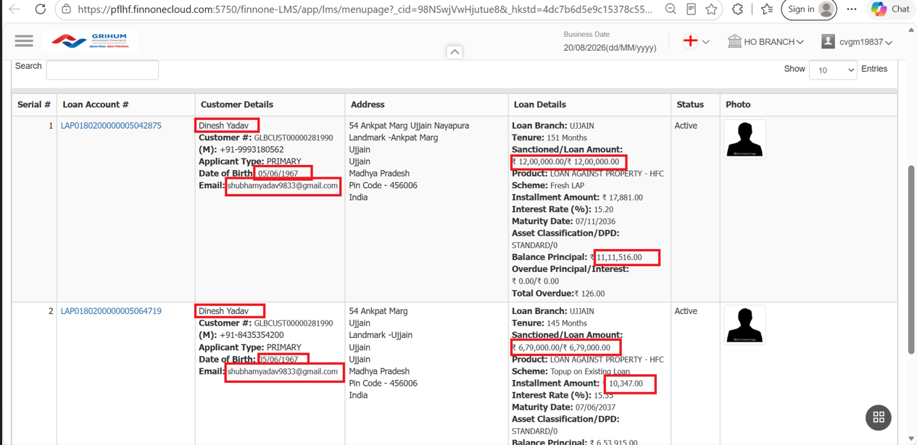
Verification - Any 3 of the below verification questions needs to be answered ​

Slide 4
CSR TAGGING​​

Slide 5
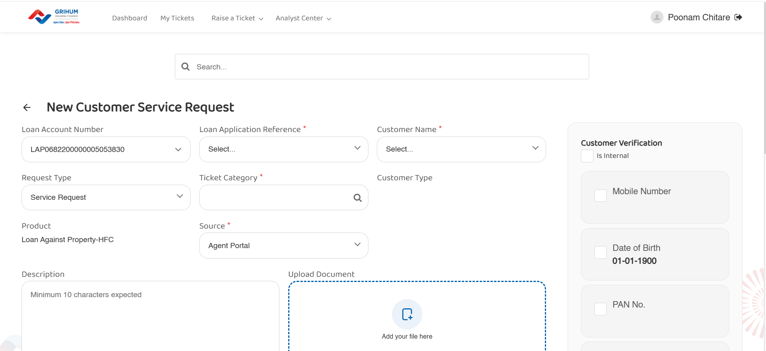

Slide 6
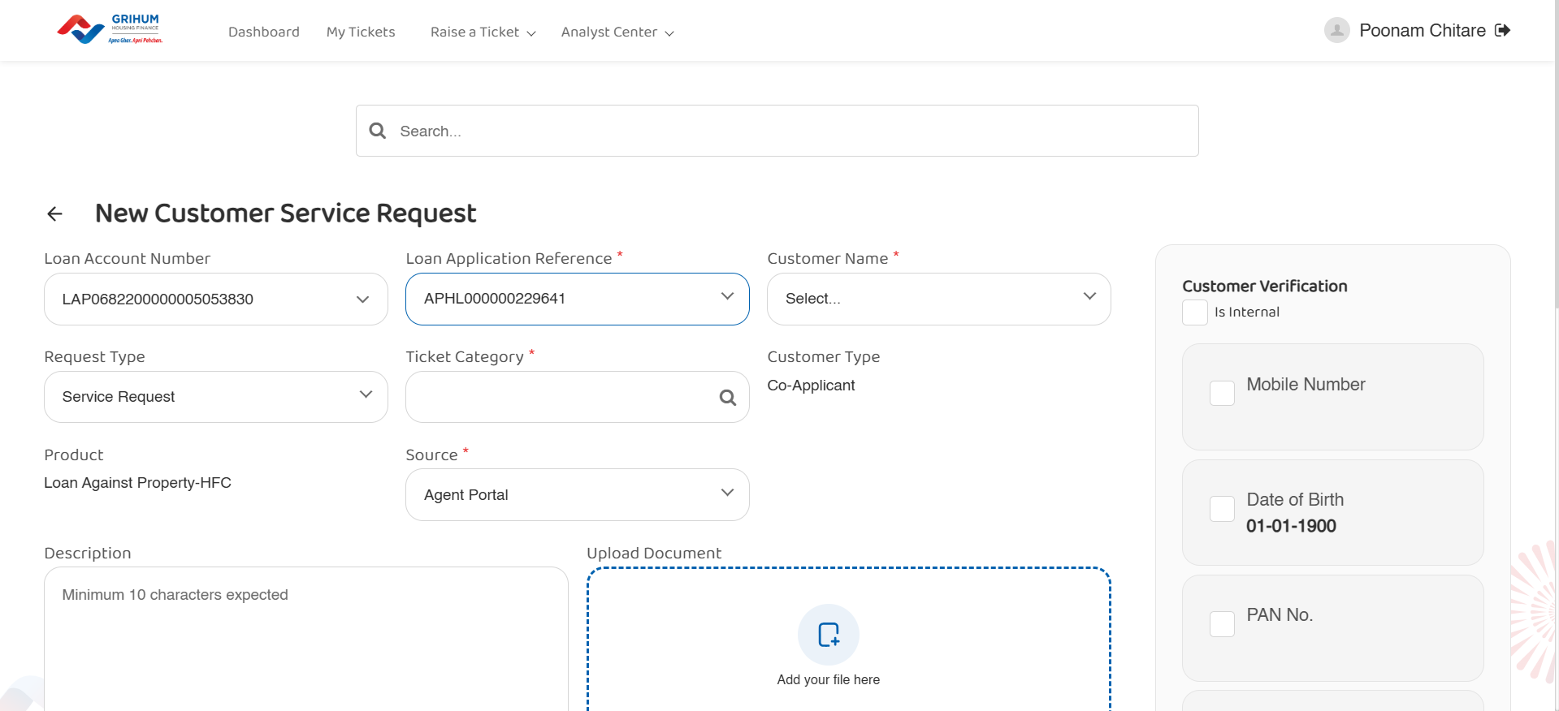

Slide 7
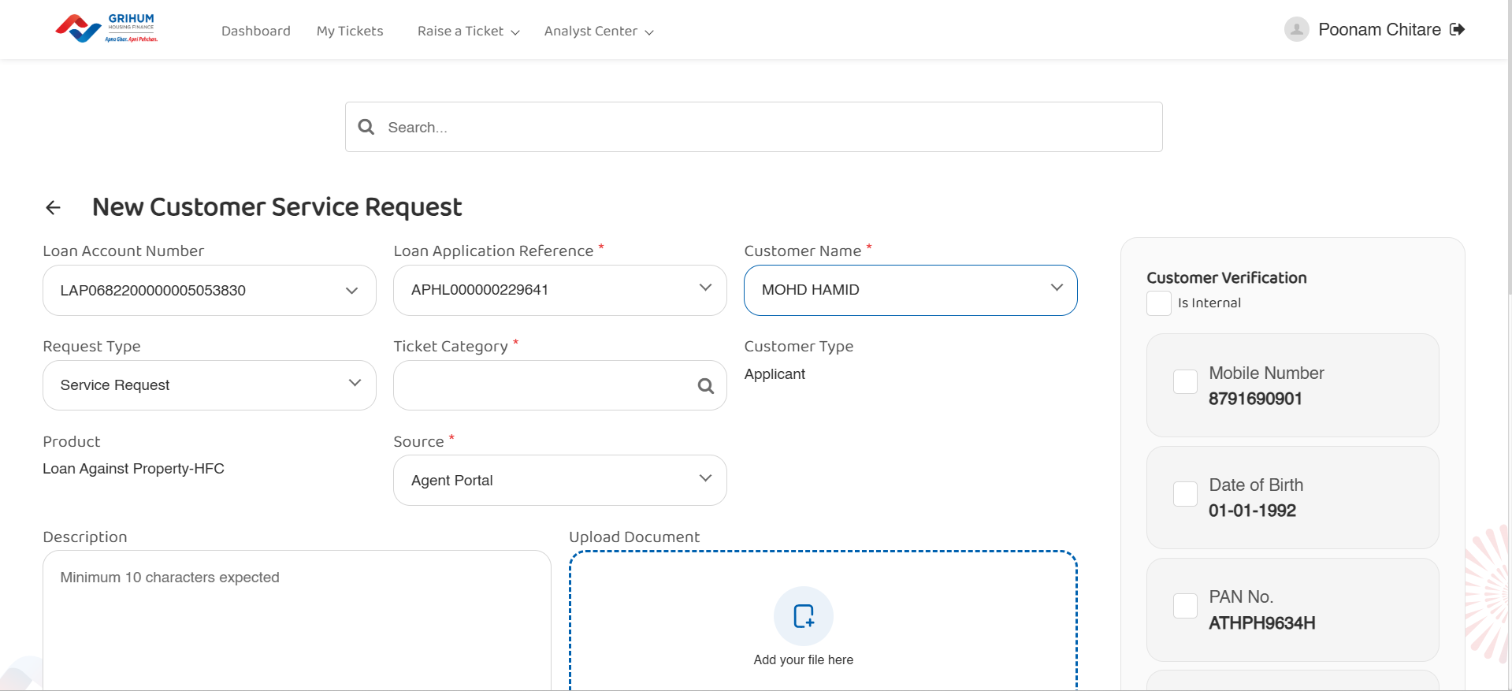

Slide 8
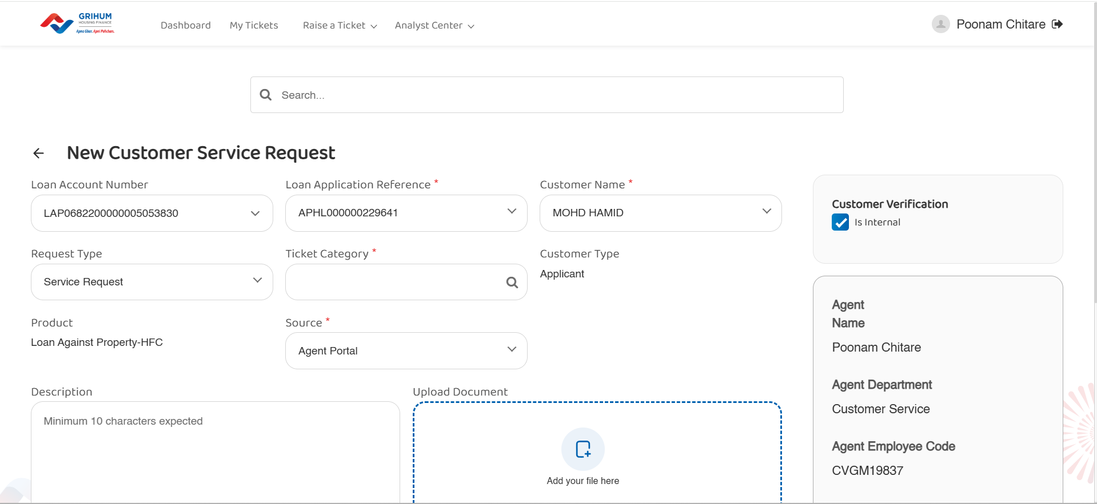

Slide 9
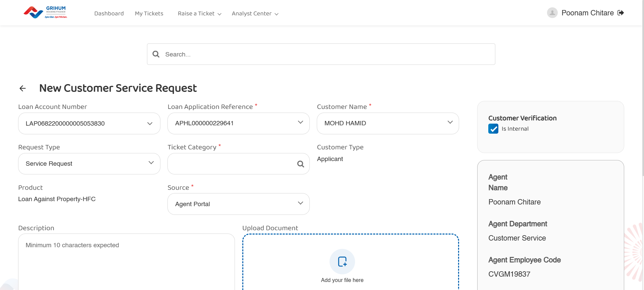

Slide 10
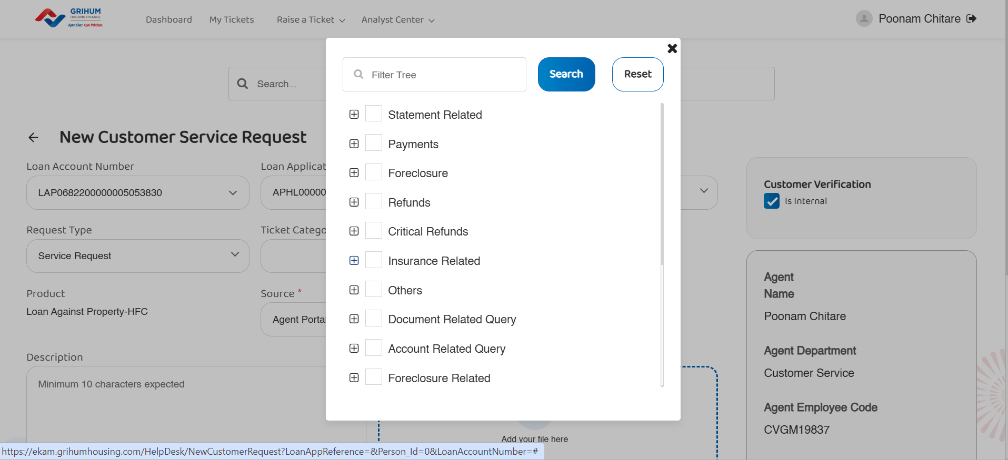

Slide 11
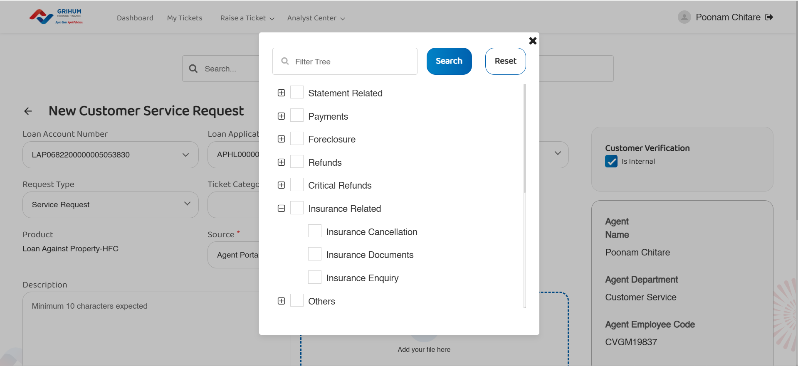

Slide 12
